Slide 1
Game Design and Programming
Neil Gannon

Slide 2
AI Behaviours
Common Behaviours
Bouncing
Jumping
Teleporting
Within Range
Moving on a Path
Advanced Behaviours
Spatial Partitioning
Pathfinding

Slide 3
Enemy Controller and Bouncing

Slide 4
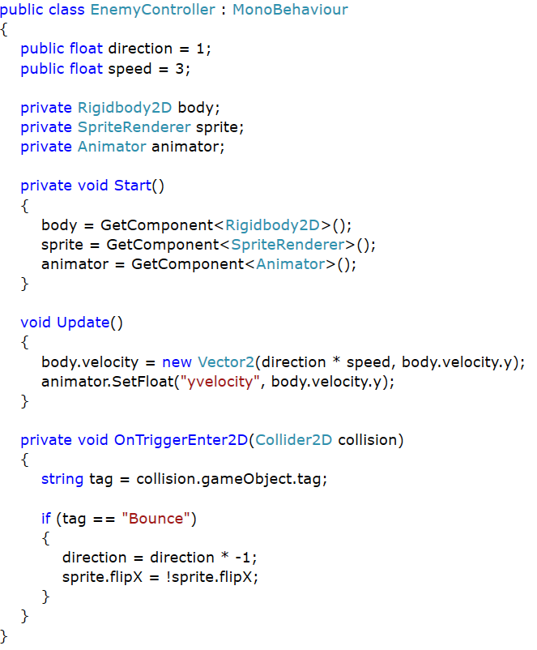
Enemy Controller
Based on the Horizontal enemy from last semester
By default will change direction when colliding with a trigger tagged as Bounce
Will also flip the sprite
Has an Animator
If the Y velocity is greater or less than 0 the animation will be a jump
Otherwise plays a walking animation

Slide 5
Jumping

Slide 6
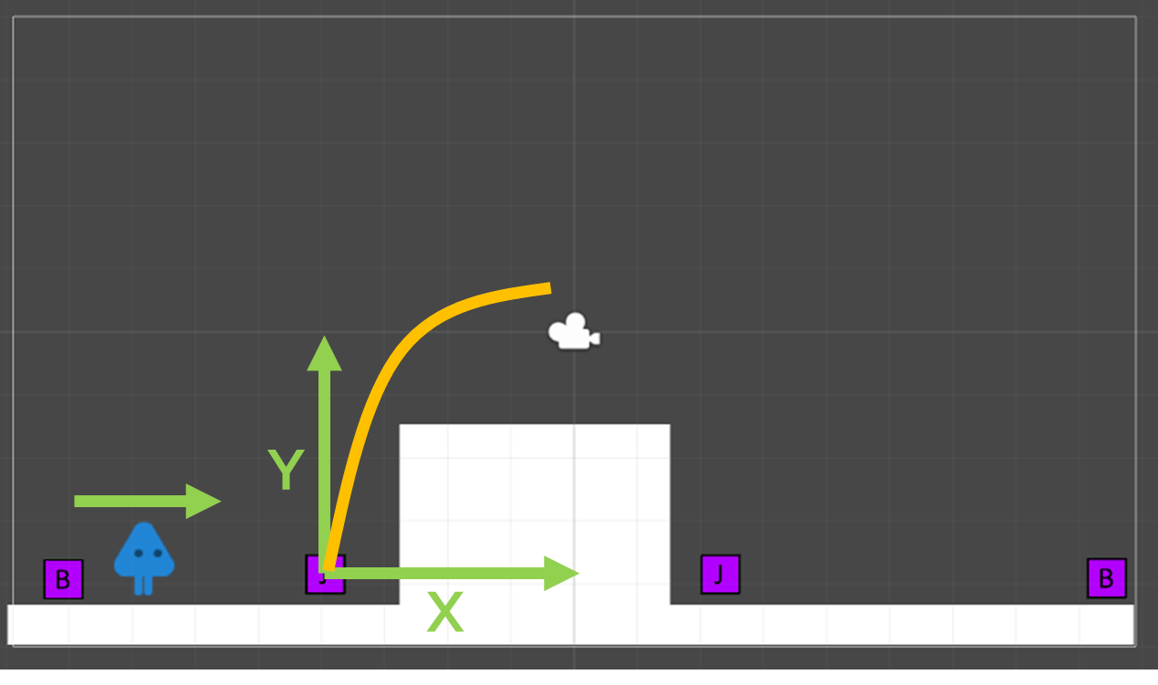
Jumping
To Jump we need to add force to a RigidBody2D
This force is Vector2
Two options to achieve this
Have the jump vector in the character
Have the jump vector stored in the object a character hits
Storing in an other object allows greater control over jumps

Slide 7
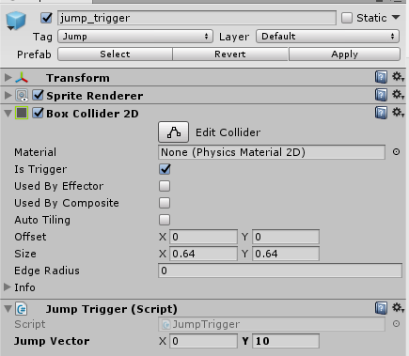
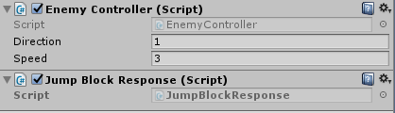
Setup
Two scripts
Jump Trigger
Jump Block Response
Jump Trigger will only work on an object tagged as Jump
Must have a collider set as a trigger
Jump Block Response can be placed on any object
Must have a RigidBody2D
The script will automatically add a RigidBody2D if one is not there already

Slide 8
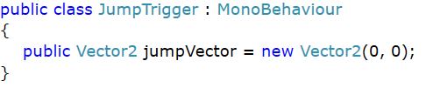
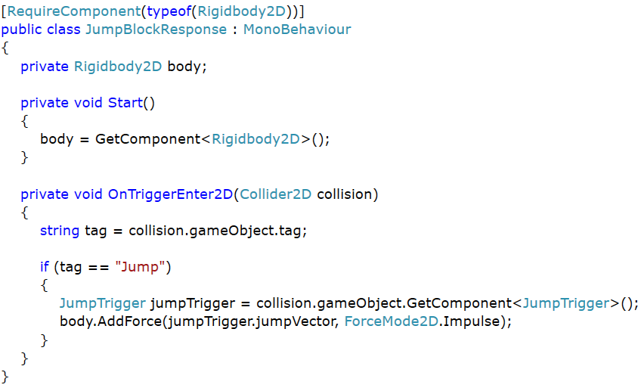
Code
Jump Trigger
Contains the jump vector for the block
Jump Block Response
Handles the collision with an object tagged as Jump
Gets the Jump Trigger from the hit object
Gets the Jump Vector from the Jump Trigger
Uses the Jump Vector to Add Force to a RigidBody2D

Slide 9
Teleporting

Slide 10
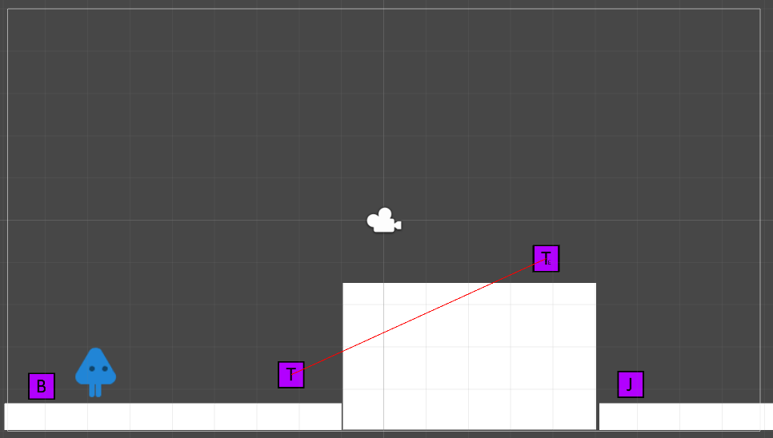
Teleporting
Teleporting can be achieved just by setting the position of an object
This can be achieved by storing the destination location in a trigger
When an object hits the trigger it should be able to get this destination and move itself there

Slide 11
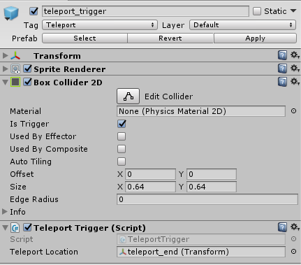
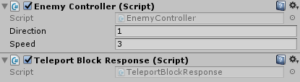
Setup
Two scripts
Teleport Trigger
Teleport Block Response
Teleport Trigger will only work on an object tagged as Teleport
Must have a collider set as a trigger
Teleport Block Response can be placed on any object

Slide 12
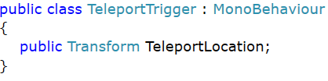
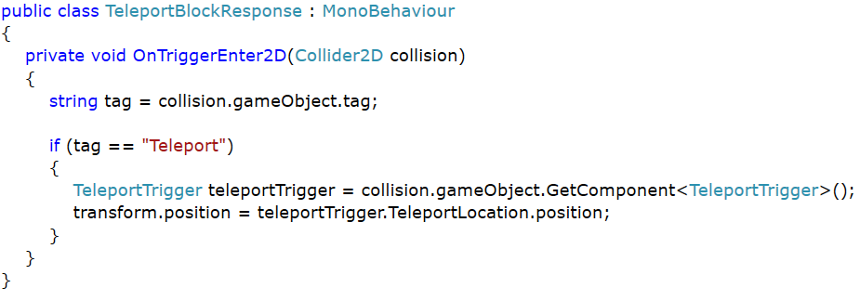
Scripts
Teleport Trigger
Contains the Transform of the object you want to teleport to
You can drag and drop and object on this in Unity
Teleport Block Response
Gets the Teleport Trigger from the hit object
Gets the TeleportLocation from the Teleport Trigger
Sets the objects position to be the TeleportLocation position

Slide 13
Within Range

Slide 14
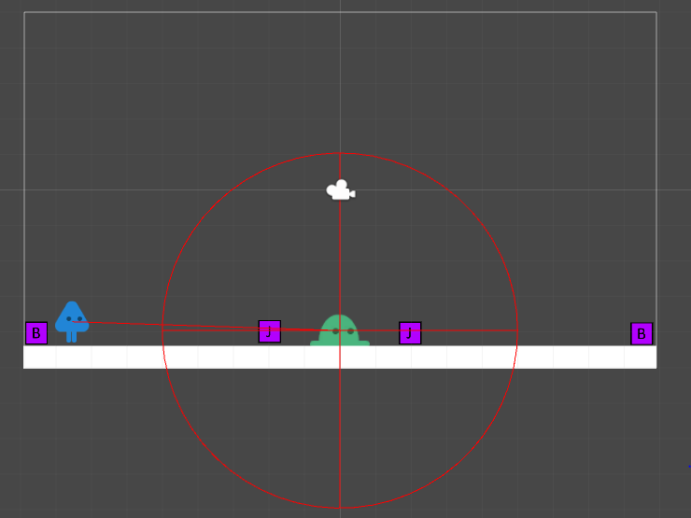

Within Range
Most games use distance as a means to determine what state an object should be in
Given the two positions we would like to measure the distance between them
If the distance is less or equal to specified range
One of the objects should react to this
The AttackInRange script can be added to any object

Slide 15
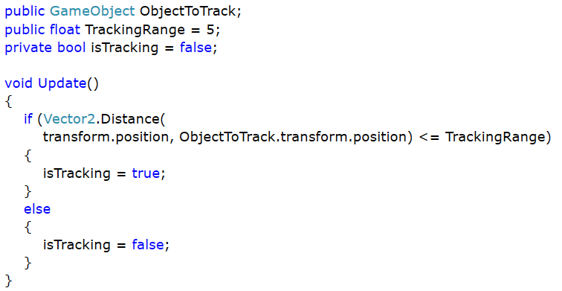
Within Range Script
Vector2.Distance
Given two Vectors (a, b) this method will return a float of the distance between them
Same as (a - b).magnitude
Recommend creating another script that watches the isTracking variable
Can then have multiple scripts that respond
Separating the distance logic from the response
Stops duplication of code for the tracking

Slide 16
Moving on a Path

Slide 17
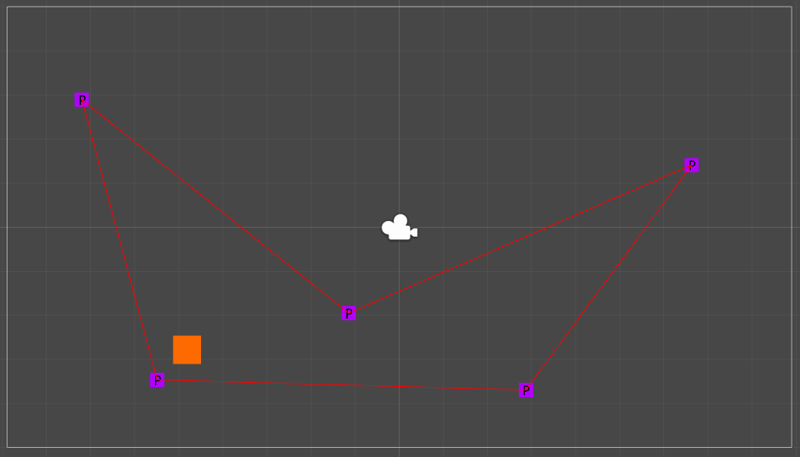
Moving on a Path
A path is collection of positions
We want to move to a position
Determine when we’ve reached the position
Get the next position and repeat forever
In order to this we need to be able to store multiple positions
Each path may a different number of positions

Slide 18
Arrays
An array is collection of items of the same data type
Allows us to create a group of related data
Has a fixed sized
Use an index to access the item we want
Index starts at zero
Index ends a the length - 1
We can perform various operations on an array
Add
Remove
Get

Slide 19
Arrays
Declaring
Use square brackets after the data type
Adding Items
Accessing Items
Must use an index that is within the range of items in the array
Key point is that the index starts at 0
The last index will always 1 less than the length of the array!

Slide 20
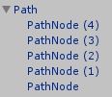
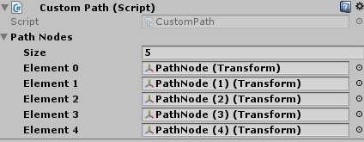
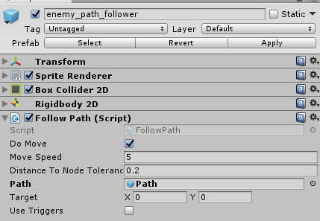
Setup
Two scripts required
CustomPath
FollowPath
Custom Path
Maintains the collection of points on the path
Responsible for returning the First point on the path and every Point after it
Note this is designed for one object to use the path!
Follow Path
Responsible for moving on the path and detecting when it has reached the point
Responsible for getting the next point from the CustomPath

Slide 21
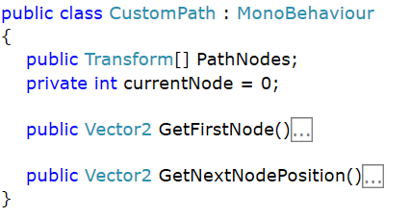
Custom Path Script
Custom Path keeps track of
An array of Transforms
An integer for keeping track of where in the array the current follower is
It is only intended for one object to use a path at a time
We can move the current node counter into the AI and allow it to track its own position
I’ll add a modified sample for this to Moodle!

Slide 22
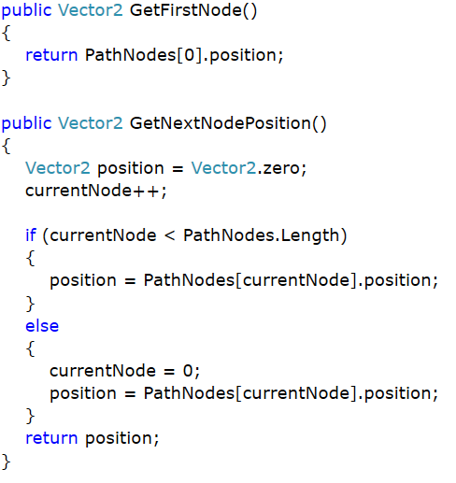
Custom Path Code
GetFirstNode
Returns the position of the first element in the PathNodes array
Array holds transforms, transforms have a Vector position
Note the starting index is zero
GetNextNodePosition
Increment the currentNode index
If the index is less than the length of array then return the array element at that index
Otherwise reset the currentNode back to zero and return the first element

Slide 23
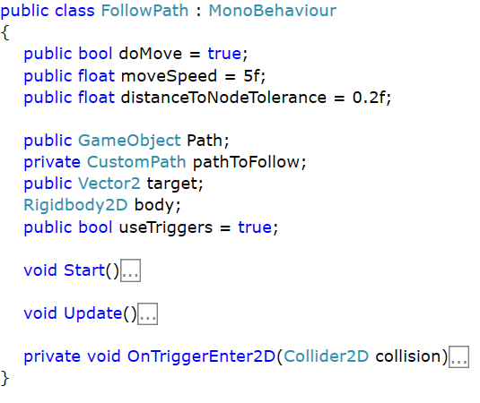
Follow Path Script
Follow path will move an object with a RigidBody2D
Move it to the target Vector2
Get the next target location when we reach the current one
Key Variables
distanceToNodeTolerance
pathToFollow
target
useTriggers

Slide 24
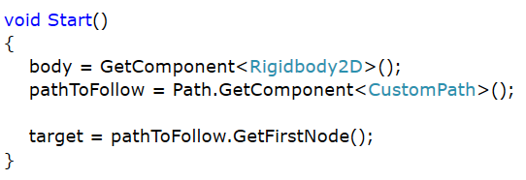
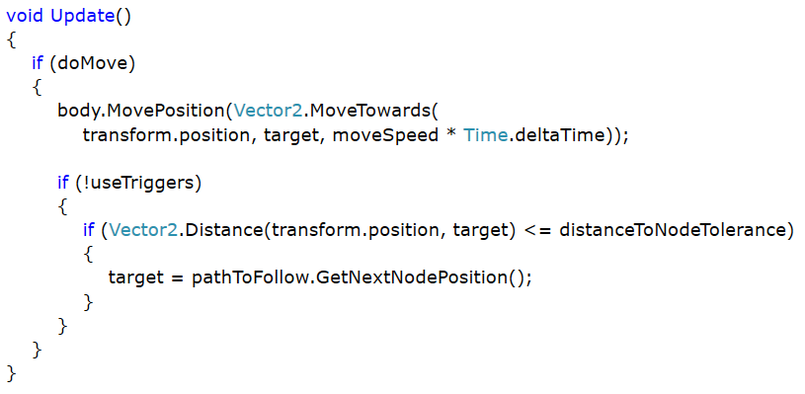
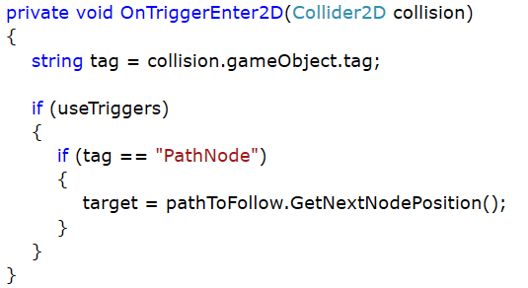
Follow Path Code
When the game starts
Get the first node in the path
In the update
Move the object towards the target position at the given speed
If the we are close to the target then get the next position in the path
Note there are two modes for this script
One that uses distance
One that uses a trigger collision

Slide 25
Pathfinding

Slide 26
Pathfinding
Pathfinding in games requires some form of structure to be applied to the game world
If an AI is to move through the world then they need data that describes where they are allowed move to
The world needs to be broken up into a consistent and structured manner
2D games typically divide the world into a grid of cells
Each cell is the same size
3D games typically extract data from mesh surfaces that define walkable areas in the world
Surface size doesn’t matter
After the world has been divided in grid a pathfinding algorithm is used to determine the optimal route through the cells

Slide 27
Spatial Partitioning

Slide 28
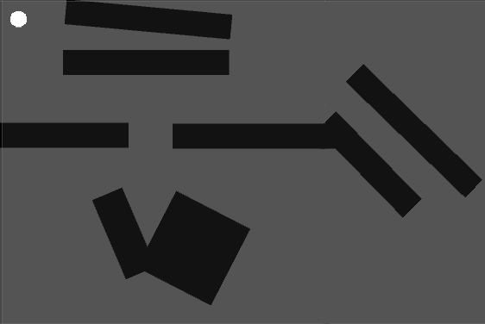
Step 1: Define the Area
Using a rectangular sprite we are going to cover the entire area of the game where an AI can move
This defines the “bounds” of the game world
Any object you do not want an AI to pass through should be tagged as “Wall”
After testing your can hide the sprite

Slide 29
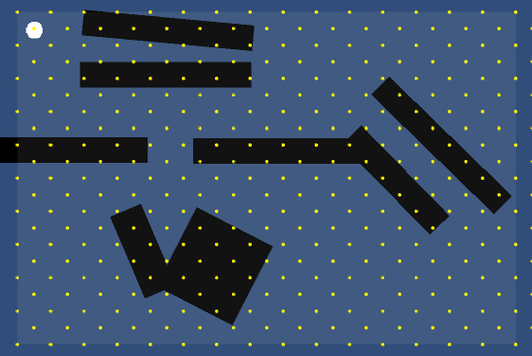
Step 2: Divide the Area
The rectangular area is then divided into an evenly spaced grid
The code we are using uses the centre of grid cell as a node that an AI can move to

Slide 30
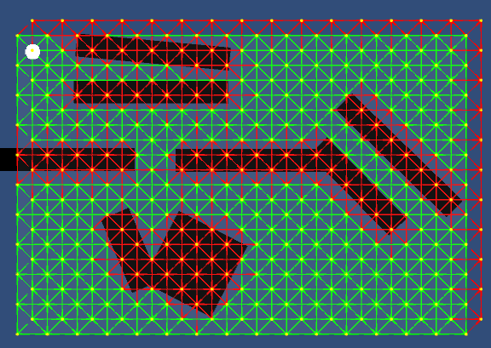
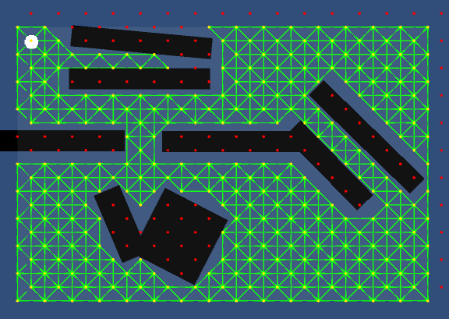
Step 3: Identify Walkable Cells
Once the grid has been created we need to identify which nodes are actually passable and which are not
A ray is cast in 8 direction from each node
If the ray hits an object tagged as wall this direction is considered unpassable
One all the unpassable routes have been removed we are left with the walkable areas in the world

Slide 31
Step 4: Use AStar to find best route
AStar Algorithm
Pathfinding algorithms are well beyond the scope of Y1 subject
Covered in later years

Slide 32
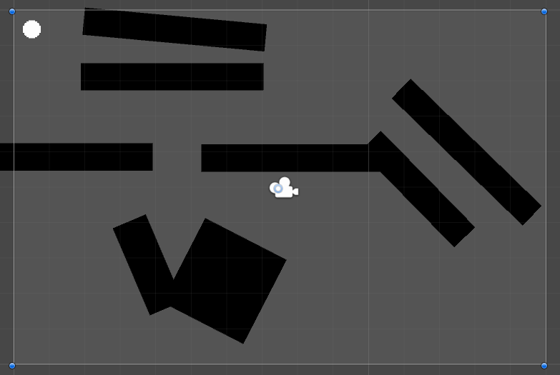
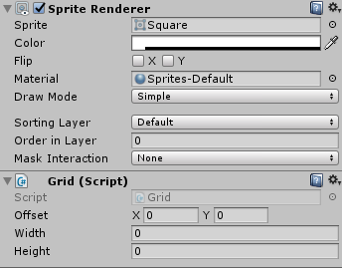

Setup (Grid)
Create an object that has a square sprite
Add the Grid script to the object
This script will automatically divide the rectangular space of the sprite into a grid
It will then identify the walkable areas
This data will then be stored for use by the pathfinding algorithm
If you wish to change the size of the cells created open the Grid script
Modify the UnitSize value

Slide 33
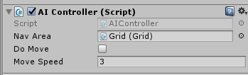

Setup (AI Controller)
Note this script can be applied to any object that uses a RigidBody2D
Not just AI Characters
This script requires that the Grid to be used is filled in
Drag and Drop the object in the scene that contains the Grid script
If you want an object to move to a point you need to provide the position of where you want to go
You need to update the line of code on threright
Found in the Update method of AIController

